Slide 1
Children’s Nursing
Prepared by:
Meldrick Magsino
Practice Educator, East & North Hertfordshire NHS Trust

Slide 2
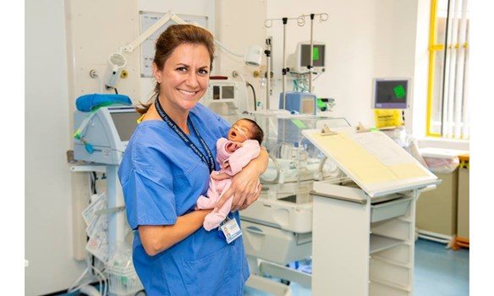
What is Children’s Nursing?
Children’s nursing specializes in taking care of newborns, children, and young people.
It involves working closely with families, including parents and carers.

Slide 3
How to become one?
Degree course at a university
Nurse degree apprenticeships
Nursing associate apprenticeships
Check out universities now

Slide 4
Must have skills
Communication and interpersonal skills
Ability to interpret a child’s behaviour and reactions
Planning and decision-making
Ability to teach and advise
Time management
Working with patience and compassion

Slide 5
Entry Requirements
Since the main route is thru a degree course in a university, typically you'll need:
a minimum of five GCSEs at grade 4/C or above, possibly in English language or literature and a science subject
two A levels or equivalent level 3 qualifications for an undergraduate degree

Slide 6
Entry Requirements
Some universities may ask for three A levels or equivalent.
If you already have a degree, you might be able to study for a postgraduate qualification.

Slide 7
Benefits of pursuing the course
Fast employment – 94% are employed 6 months after graduation
Adequate support – student loans, financial aids
Chance to make a real difference – saving people’s lives

Slide 8
Benefits upon employment
Wide range of opportunities and specialities to choose from
Working with expert health professionals from various fields
Standard working week – 37.5 hours

Slide 9
Benefits upon employment
Paid on the Agenda for Change (AFC) pay system, typically starting as Band 5
Access to NHS Pension Scheme and health service discounts
27 days of annual leave plus bank holidays

Slide 10
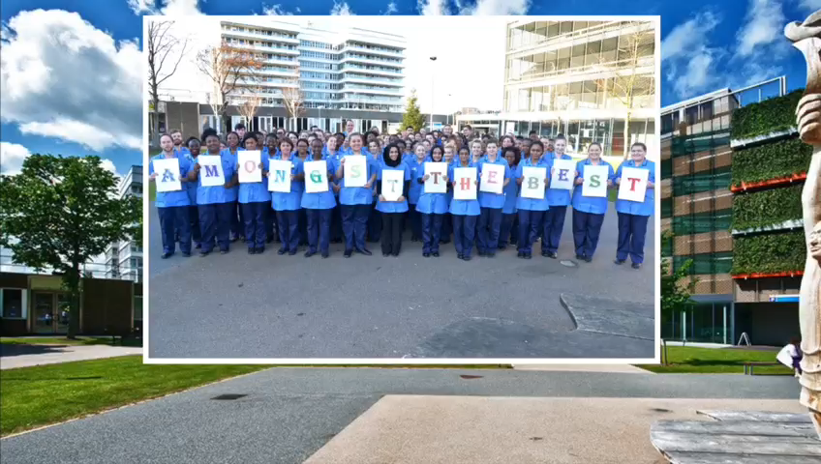
Testimonial Video 1
https://youtu.be/2sR80M2FPD4

Slide 11
Testimonial Video 2
https://youtu.be/AeecCKeTbb0

Slide 12
References
https://www.nmc.org.uk
www.healthcareers.nhs.uk

